Slide 1
So How Do I Get Started?
Launching A Next Gen Sector Partnership
Step-by-Step
January 10, 2018
www.NextGenSectorPartnerships.com

Slide 2
Welcome
John Melville, CEO, Collaborative Economics
and Member of the Next Gen Organizing Team

Slide 3
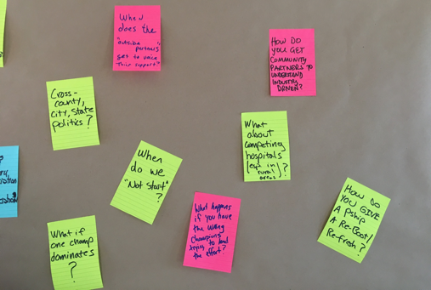
What to Expect from Today
A better understanding of the steps required to successfully launch a next gen sector partnership
References to specific tools in the Next Gen Toolkit that can help you put your learning into practice
Opportunities to ask questions after we cover each step, so be ready!
Notes:
John
1:02
Purpose of this webinar, why we’re doing this, who we hope you share this with, 3 hoped-for-outcomes

Slide 4
Getting Started
It is a Disciplined, Replicable Process, Not a Mysterious, Unique Occurrence
STEP 1: Build a regional sector support team—a joint decision-making body
Make the Case for a New Approach
Build a Broad-Based Support Team
Select a Convener/Co-conveners
Notes:
Francie
Replicable process. Not mysterious. But, takes time! Develop relationships.

Slide 5
What is This and Why Should I Care? Making the Case, Describing the Approach
TOOL: “ABOUT NEXT GEN PARTNERSHIPS” SECTION ON WEBSITE
Notes:
Lindsey – slides 3-12 (12 minutes)
Video – 4 minutes
Agnes – Slides 14-20 (15 minutes)
John – Slides 21-22 as re-cap (8 minutes)
Lindsey – slides 23-27 big picture (3-4 minutes)

Slide 6
Ways to Make the Case for the Next Gen Approach—What Works
Describe current reality, why it’s not working, and pose an alternative that makes practical sense
Define Next Gen and emphasize its outcomes
Discuss “what’s in it” for both business and community partners
Differentiate from other approaches
Deploy different modes of communication (words, video, how-to resources from Next Gen website)

Slide 7
Growing Good Jobs
Connecting
People with Good Jobs
+

Slide 8
A TYPICAL STATE OF PLAY
City Economic Development Organization
Community College
Private Training/school
Chamber of Commerce
Regional Economic Development Organizations
County Economic Development Organization
Workforce Development Board
Adult Basic Education
University
Job Center services
VR, Vets, Older Worker Programs
K-12 CTE

Slide 9
MANUFACTURING
TRANSPORTATION & LOGISTICS
HEALTH CARE

Slide 10
THE PROBLEM
Collaboration is really hard – no one’s in charge, everyone’s busy
No Common Point of Accountability
Different missions, funding streams, performance metrics, etc.
Temporary Common Points of Accountability created via grants
E.g temporary shared target population (Opportunity Youth, Vets, Low-income, STEM students, etc)
Everyone hearing same call-to-action: more, better, stronger partnerships with industry
. . . AT WHAT RISK?

Slide 11
UNINTENDED CONSEQUENCES
Employer fatigue (or some missed altogether)
No critical mass of employers = no integrity in how training programs are developed.
Students/jobseekers don’t get the right education at the right time. Think about student perspective.
“This is the door I went in. It must be the right door.”
“This is where I am now. I better make the best of it.”
Undersupply the labor market = companies leave.
Over-saturate the labor market = people don’t get jobs + wage depression.

Slide 12
THE ALTERNATIVE
Instead of engaging employers around our agenda…
Developing a new training program
Advising on curriculum
Writing a letter of support for a new industrial park
…business leaders define and champion their own agenda and public partners participate as supporters.

Slide 13
A DIFFERENT WAY OF
DOING BUSINESS

Slide 14
A DIFFERENT WAY OF
DOING BUSINESS

Slide 15
A DIFFERENT WAY OF
DOING BUSINESS
Future State: Industry Identified Priorities at the Center of Business-Driven Partnership

Slide 16
A DEFINITION: NEXT GENERATION SECTOR PARTNERSHIPS
Regional partnerships of business leaders within one industry, who work together with public partners from economic development, workforce development, education and training, and other community organizations, to address the shared workforce and broader competiveness needs of their industry.

Slide 17
INDUSTRY-LED SECTOR PARTNERSHIP
Business
Table
Convener
Designs by
Notes:
convener – what does it take to be a convener – neutral broker, interested in the success of the industry, the workers and the workforce system. A champion for all parties.
One job – to create a space where information can be gathered in a more organized and effective manner so that actionable steps result.

Slide 18
INDUSTRY-LED, COMMUNITY SUPPORTED SECTOR PARTNERSHIP
Community Colleges
K-12
Community Partners
Universities
Chambers of Commerce
Business
Table
Community-Based Organizations
Economic Development Organizations
Workforce Development
Convener
Designs by

Slide 19
FOUR OPERATING PRINCIPLES
Industry pull vs. program push
Shared table (not owned by any single institution or system)
Business/industry invested for the long haul
Integrated response from education, workforce and economic development vs. one-off solutions

Slide 20
WHAT DO THEY ACCOMPLISH?
Education and training
Definition and resolution of key talent issues
Short-term training
Consortia training
Incumbent worker training
Long-term training and education programs (including career pathways)
Work based learning
Economic Development
Shared marketing and branding of the region and industry
Supply chain mapping and coordination
Shared transportation costs
Infrastructure improvement
Regulatory or permitting process streamlining
Company-to-company networking
Non-training
Improved HR practices
Third party screening and assessment
Hire local campaigns
Career awareness campaigns
Aligning job descriptions with actual KSAs

Slide 21
WHY A NEXT GEN APPROACH?
Impact of Partnership on Businesses
82% have businesses with new or enhanced products and/or markets
91% have businesses that have found support in finding employees with the skills and experiences their business needs
82% have businesses that have developed new recruitment practices
Impact of Partnership on Jobseekers and Students
71% increased student/jobseeker awareness of training/education programs.
62% experienced increased program alignment across secondary, post-secondary, and/or workforce programming.
67% enhanced existing or developed new training/education program(s).
TOOL: MODULE 5: Success Metrics of Next Gen Sector Partnerships
Notes:
Example of the impact.
Across the nation there is recognition across workforce, economic development, and education that we must do more with less.
Proven effective.
A new way of doing business – next gen sector partnership
Example from one state with 21 active partnerships across the state
Impact on Businesses
82% of sector partnerships have businesses that have developed new or enhanced ideas for new products and/or markets as a result of their participation in the partnership.
91% of sector partnerships have businesses that have found support in finding employees with the skills and experiences their business needs as a result of their participation in the partnership.
82% of sector partnerships have businesses that have developed new recruitment practices* as a result of their participation in the partnership
Impact on Jobseekers and Students
71% of partnerships increased student/jobseeker awareness of training/education programs.
62% of partnerships experienced increased program alignment across secondary, post-secondary, and/or workforce programming.
67% of partnerships enhanced existing or developed new training/education program(s).

Slide 22
Getting Real: Typical Trajectory of Next Gen Sector Partnerships

Slide 27
Next Gen Sector Partnerships are Different from:
Workforce Development Board
Chamber of Commerce
Education Advisory Board
Career Pathway Employer Groups
Economic Development Organization
Industry Association
Focus Groups

Slide 28
www.nextgensectorpartnerships.com

Slide 29
Build a Broad-Based Support Team
Think beyond workforce—include education, economic development, and others with a stake in successful sector partnership building
Pay attention to people—target leaders/ influencers/doers, vs. representatives/free riders/opponents. Assemble the “coalition of the willing”…important to have the right “first responders”
Address concerns early—set ground rules, make it formal as necessary to build trust

Slide 30
Select a Convener/Co-Conveners
Seen as Neutral
Trusted, Credible with Business and other Community Partners
Able to Play Strong Roles
Coordinate
Communicate
Connect
Facilitate
TOOL: Job Description for Sector Partnership Conveners

Slide 31
Questions?
STEP 1: Build a regional sector support team—a joint decision-making body
Make the Case for a New Approach
Build a Broad-Based Support Team
Select a Convener/Co-conveners
Notes:
Francie
Replicable process. Not mysterious. But, takes time! Develop relationships.

Slide 32
STEP 2: Identify and agree on sectors that merit your collective action
Start by compiling and organizing labor market information for your region
Identify candidate sectors that are key drivers of your regional economy
Apply “readiness testing” to each of your candidate sectors
Choose your most-ready sector for your first launch

Slide 33
Start with Labor Market Information
Organize into decision-making spreadsheet
Look at the data together as a team
Have LMI specialists on hand to answer questions as partners, but not decide sectors for the group
Use the discussion questions that we provide
TOOL: How to Use Labor Market Information

Slide 34
But Be Aware…
Know what LMI will give you . . .
A baseline of real information
A way to prioritize
Avoid the “Picking winners and losers” trap
You have limited collective resources. Use them well.
A starting place for a conversation
Know its limitations. . .
No data set is perfect
There is usually a lag
There is always missing data
There is always too much data!
Beware: Analysis Paralysis
There is no substitute for actual conversations with employers

Slide 35
Getting the Scope Just Right
Geographic scope?
Industry scope?
Number of businesses?
Jurisdictional boundaries?
TOOL: Getting the Scope Just Right Worksheet

Slide 36
Conduct Readiness Testing
Leadership?
History?
Local Conditions?
External Forces?
TOOL: Industry Readiness Worksheet

Slide 37
Questions? STEP 2: Identify and agree on sectors that merit your collective action
Start by compiling and organizing labor market information for your region
Identify candidate sectors that are key drivers of your regional economy
Apply “readiness testing” to each of your candidate sectors
Choose your most-ready sector for your first launch

Slide 38
STEP 3: PREPARE TO LAUNCH
Build a list of industry champions
Identify and cultivate potential business co-chairs
Champions/co-chairs send out invitation to launch meeting that they host
Notes:
Francie

Slide 39
Build a List of Industry Champions and Identify/Cultivate Co-Chairs
Recruit for Key Traits (Civic Entrepreneurs)
Decision-makers in their businesses
Passionate about their industry
Passionate about their community
TOOLS:
How to Choose an Industry Champion
Talking Points to Recruit Champions

Slide 40
Build a List of Industry Champions and Identify/Cultivate Co-Chairs
How to Find a Critical Mass of Them
Tap collective knowledge of Sector Support Team, applying civic entrepreneur criteria
Leverage collective business relationships of Sector Support Team, sharing contacts and making outreach assignments
Prioritize and secure initial “champions” or “co-chairs” then ask them to identify others like them to build out the invitation list

Slide 41
Champions/Co-Chairs Send Out an Invitation Letter and Host Launch Meeting
Imperative that it is a business-to-business “Ask,” not an invitation from the Sector Support Team
Ideal if launch meeting is held at one of the champions/co-chairs place of business, reinforcing the business-to-business theme
Keep champions/co-chairs informed of RSVPs and ask them to nudge key people to attend, helping them take ownership of their meeting
TOOL: Sample Launch Invitation Letter

Slide 42
Questions? STEP 3: PREPARE TO LAUNCH
Build a list of industry champions
Identify and cultivate potential business co-chairs
Champions/co-chairs send out invitation to launch meeting that they host
Notes:
Francie

Slide 43
STEP 4: LAUNCH
Get businesses leaders talking about opportunities
Identify shared priorities for action
End with commitments
Remember: This is a business-to-business conversation; community partners are in listen mode only so businesses can find their collective voice, set shared priorities, and develop ownership of their own agenda for action
Notes:
Francie

Slide 44
Key Ingredients for Success
Focus first on opportunities for industry growth and competitiveness, not problems, issues, or “pain points”
Focus second on requirements to capitalize on top industry opportunities, surfacing priorities that are key to future success
Always close by asking for personal commitments from industry leaders, which confirms priorities “worth working on”

Slide 45
We Provide Detailed Guidance on How to Conduct a Launch Meeting
TOOL: Suggested Meeting Set-Up
TOOL: Sample Launch Agenda
TOOL: Detailed Launch Facilitation Guide
TOOL: Simulations—Facilitating a Launch Meeting

Slide 46
QUESTIONS? STEP 4: LAUNCH
Get businesses leaders talking about opportunities
Identify shared priorities for action
End with commitments
Notes:
Francie

Slide 47
STEP 5: MOVE TO ACTION
Form action teams around priority areas
Bring in the right support slowly and selectively
Focus on early wins
Sustain & evolve
TOOL: See The Next Gen “After Party” Webinar in the Community of Practice and Step 5 tools
Notes:
Francie

Slide 48
Some Frequently Asked Questions We Get
How do we define the scope of our industry partnership?
Why isn’t industry input via survey and focus groups enough?
We don’t have strong employer relationships, how do we get them to the table?
What are the top myths about engaging employers?
Aren’t we leaning too much to the industry side, what about jobseekers needs?
What about low-road employers and industries—do we set up a partnership with them?
What if employers identify priorities with which we disagree?
Why should community colleges or economic development care?
What are top things to consider for a rural partnership? For an urban partnership?
What about the staff capacity necessary to support sector partnership building?
TOOL: Frequently Asked Questions About Next Gen Sector Partnerships
Notes:
Francie

Slide 49
The Next Gen Difference
PEOPLE
Business Champions/Civic Entrepreneurs (passion for industry & community)
Community “First Responders” (listen, pull from toolkit, combine with others, authority to make decisions and move resources)
PROCESS
Disciplined and Replicable: Opportunities/Requirements/Champions/Early Wins/Momentum
Prioritized Business Growth Agenda (vs. workforce-only, grant, or other agendas)
PARTNERSHIP
Business Champions are Co-owners in Partnership (vs. customers or contributors)
Coalition of the Willing To Act (vs. sightseers, free riders, and naysayers)

Slide 51
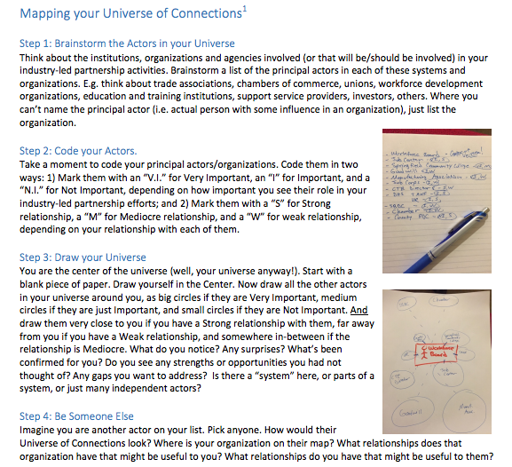
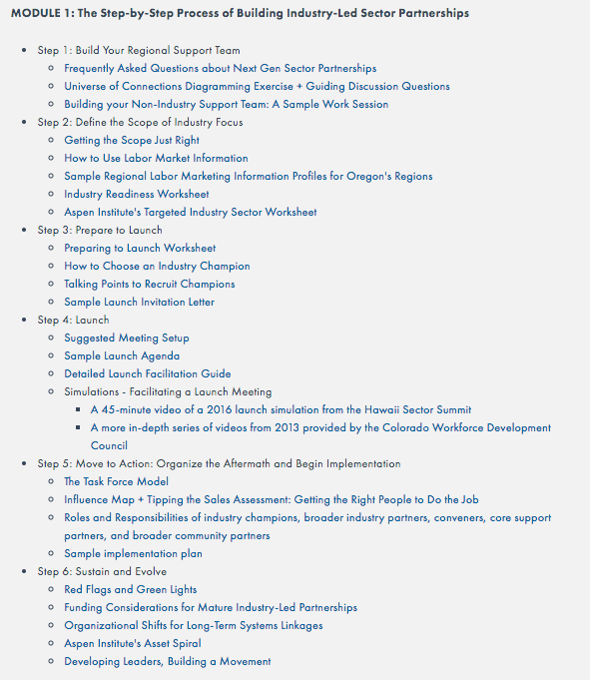
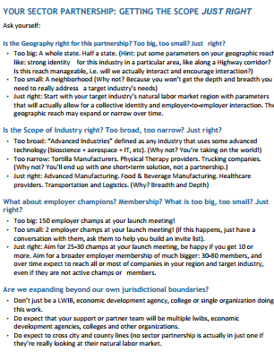
Notes:
1:32-1:40
These look different in every region across the country but there is a discipline to this process.
Walk through step-by-step, 2 minutes each, focusing on building regional support team (don’t do this alone); Choosing industry of focus (remember why you’re doing this – jobs and getting people into jobs); preparing to launch; and launching.
Plug next webinar “the after party” as a chance to go deeper into what happens after the launch

Slide 52
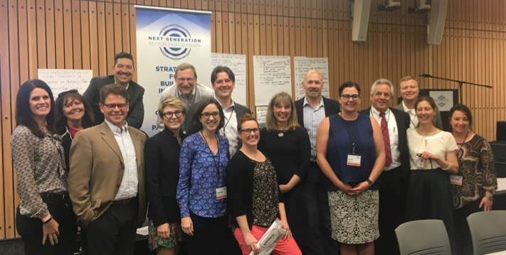
Thank you!
Notes:
John
2:29-2:30
A big thank you to all of you for taking the time today to learn more about next generation sector partnerships--and specifically how to navigate the After Party. It is for you the practitioners that we have created this national community of practice. So, stay connected, help each other, use the tools, and let us know how we can make these experiences better and better in the future.

