Slide 1
The After Party!
What Do You Do After Launching a Next Gen Sector Partnership?
May 4, 2017
Notes:
John
1:00-1:01
Welcome everyone to today’s webinar on The After Party: What Do You Do After Launching a Next Gen Sector Partnership? We are so glad you could join us today. John does self-introduction

Slide 2
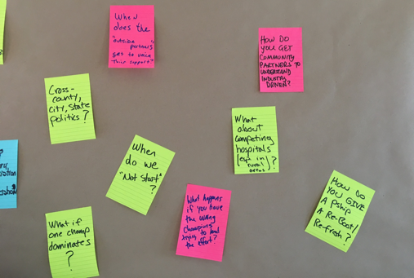
What to Expect from Today
A better understanding of what to do immediately after a successful next gen sector partnership launch
A clearer sense of what works and what to avoid in the transition from launch to implementation
Learning from the different journeys of two regions from the practitioners themselves
Notes:
John
1:02
Purpose of this webinar, why we’re doing this, who we hope you share this with, 3 hoped-for-outcomes

Slide 3
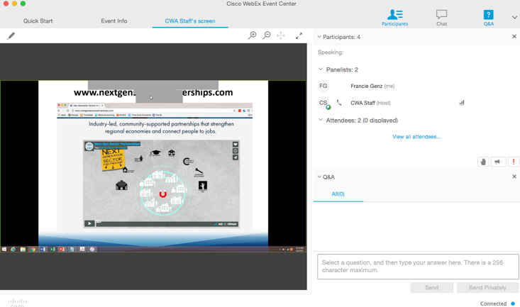
Do you know where your Chat box is? (and do you know how to use it?)
Notes:
John
1:03-1:04
But first a few logistics – do you know where your chat box is? Do you know how to use it? In case you’ve forgotten . . . Now you give it a try. We’d love to see you introduce yourselves – type your name and where you’re logging in from, let’s see who we get . . . This is the box you will use to pose questions during the webinar

Slide 4
Poll: What’s Your Situation with Next Gen Sector Partnerships?
Notes:
John
1:05-1:07
We want to get a quick sense of who’s on the line. You’ll see an option to complete the poll on your screen.
Did you attend the next gen academy in Phoenix? A) yes B) No
What’s your current situation regarding next gen partnerships?
I have already launched a next gen sector partnership and am trying to navigate the After Party stage right now!
I am planning to launch a next gen sector partnership, and want to be prepared for the After Party
I am new to next gen sector partnerships, and want to learn more about the whole process
I am joining this webinar in hopes of winning a prize
Yes that’s right we will have prizes for the best question and the most questions asked--we value both quantity and quality!

Slide 5
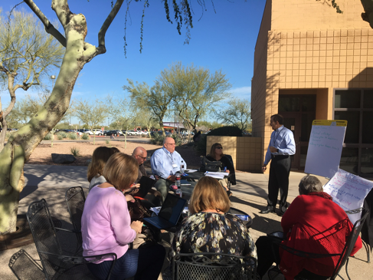
Let the After Party Begin!
Notes:
John
1:08: Let’s dig in! Today we have two terrific practitioners, who also served as faculty at the National Academy in Phoenix: Kristina Payne from Oregon and Lynn Vosler from Colorado. They are going to share their experiences with their post-launch after parties--what worked well and not so well. But before they dig in, let me first provide an overview of where to find helpful tools and what we have learned working “after parties” across the country.

Slide 6
INDUSTRY-LED, COMMUNITY SUPPORTED SECTOR PARTNERSHIP
Community Colleges
K-12
Community Partners
Universities
Chambers of Commerce
Business
Table
Community-Based Organizations
Economic Development Organizations
Workforce Development
Convener
Designs by
Notes:
John
1:09
Let’s set the scene: you have just successfully launched a next generation sector partnership, with industry at the center, priorities identified, business champions have volunteered to work together on the priorities, and you and other community partners have listened intensely as the business champions have found common ground. Now what?

Slide 7
www.nextgensectorpartnerships.com/toolkit
Notes:
John
1:10
Well, you consult the Next Generation toolkit of course! There are lots of practical tools, templates, and advice in there--and more on the way! Here is where to look: see Module 1 and follow the step-by-step process to Steps 5 and 6.

Slide 8
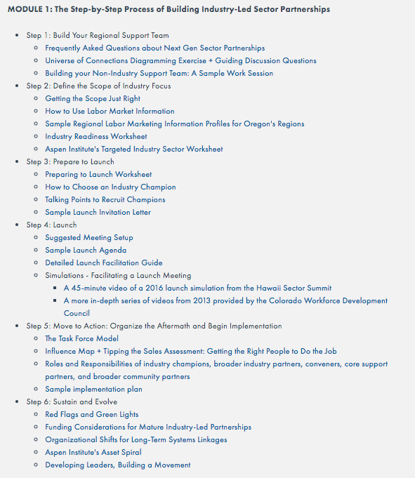
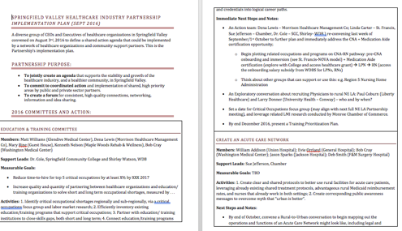
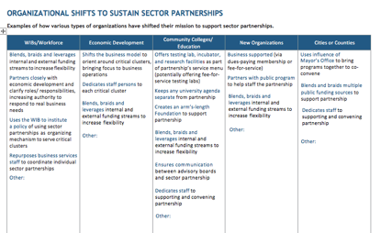
Notes:
John
1:11
I’m not going to go through all the tools now, but they include: how to put together task forces/action teams, roles and responsibilities for industry champions and community partners of all kinds, sample implementation plan, warning signs, funding considerations, and how to think about longer-term organizational shifts to support next gen sector partnership building in your region.

Slide 9
What We Find Works
Making Sure Business Partners Own Their Priorities
Carefully Selecting the First Responders
Mastering the Meshing Process
Building for the Long Term
Notes:
John
1:12
But, let me boil some of this down into a few takeaways for this webinar, to get us thinking about what it takes to have a successful After Party. This is what we find works from our experience across the country.

Slide 10
Business Leaders Become Owners
Immediate launch follow-up to refine/solidify priority outcomes and actions
Discipline of the written action plan
Evolution of business roles
From Agenda-Setter to…Recruiter, Expert, Advocate, Investor, Catalyst, Communicator, Innovator, Worker Bee, and More
Notes:
John
1:13-1:15

Slide 11
First Responders Are Carefully Chosen
Can commit organization’s resources (not a representative)
Is sensitive to keeping business champions engaged (not driving own agenda)
Views their organization’s resources as a toolkit (not pre-packaged, stand-alone “solutions”)
Is collaborative and positive-sum (not competitive, zero-sum)
Notes:
John
1:16-1:18

Slide 12
Mastering the Meshing Process
Ask probing questions to deeply understand desired outcomes of business champions (not quick answers)
Explore resources (“tools”) from different organizational toolkits that can be combined (not quick fixes)
Map out collaborative approaches and complementary roles (not handed-off to one partner)
Define specific early wins (not just general goals)
Notes:
John
1:19-1:21

Slide 13
Building for the Long Term
Build trust by achieving and honestly assessing early wins (not breaking trust by not following through)
Use early wins as a pivot to defining and achieving “next wins” (not declaring victory and moving on)
Progressively address organizational and sustainability needs (not too much organization too early, creating a distraction or turf war)
Shift organizational roles and operations (not keep as “add on”)
Notes:
John
1:22-1:24

Slide 14
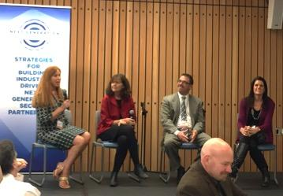
What has been your role in your regions’ next gen sector partnerships?
What happened after your Launch? What steps did you take?
What worked well (and not so well)?
Kristina Payne and Lynn Vosler
Kristina is Executive Director of the Lane Workforce Partnership, Eugene Oregon
Lynn is Director of Workforce Solutions,
Front Range Community College
Fort Collins, Colorado
Notes:
John
1:25 Introduce panelists--and remind people to submit questions and we will work them in as we go along. Pose the questions. Keep track of best and most questions.
1:26-1:41: Kristina and Lynn answer these three questions (with John follow-up)

Slide 15
How have the roles of your business champions evolved?
What has made the difference in getting things done? Business ownership, good “first responders,” effective Meshing Process?
Kristina Payne and Lynn Vosler
Kristina is Executive Director of the Lane Workforce Partnership, Eugene Oregon
Lynn is Director of Workforce Solutions,
Front Range Community College
Fort Collins, Colorado
Notes:
John
1:42 John poses the questions, reminds people to input their questions (keeping track of best and most questions)
1:43-2:03 Lynn and Kristina answer questions, John follows-up and also works in webinar participant questions

Slide 16
What is critical in building for the long-term?
How are you specifically addressing organizational, funding, and other sustainability challenges?
Kristina Payne and Lynn Vosler
Kristina is Executive Director of the Lane Workforce Partnership, Eugene Oregon
Lynn is Director of Workforce Solutions,
Front Range Community College
Fort Collins, Colorado
Notes:
John
2:04 John poses questions, reminds people to submit their questions (keeping track of best and most questions)
2:05-2:25: Francie makes transition comment and hands to Lindsey for the How

Slide 17
Wrap Up
Remember to fill out survey
Save the date for upcoming webinars:
Scaling at the State-Level: How States have Successfully Scaled Next Gen Sector Partnerships. Thursday June 1st, 1-2:30pm EDT
Details at www.nextgensectorpartnerships.com/community-of-practices
Notes:
John
2:26-2:28 Recap of major themes covered in the discussion – we’ve covered a lot of ground and it’s a lot to remember. Reminder – use the toolkit as your go-to source of information and resources.
Reminders of upcoming webinar
Reminder to fill out survey
Big thanks to panelists
Announce prize winners. The winners are: for most questions _______. For best question_____. You each will receive free customized, follow-up coaching call from the Next Gen Team to hear more about your specific situation and offer our best advice on how to proceed.
And, with that… (flip slide)

Slide 18
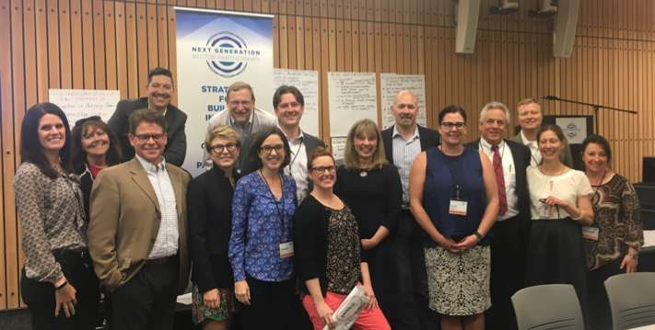
Thank you!
Notes:
John
2:29-2:30
A big thank you to all of you for taking the time today to learn more about next generation sector partnerships--and specifically how to navigate the After Party. It is for you the practitioners that we have created this national community of practice. So, stay connected, help each other, use the tools, and let us know how we can make these experiences better and better in the future.

